Slide 1

Problem Statement 1 : AI/ML
By Decision Makers:
Ayushkumar Yadav
Mohit Mande
Balsharan Singh Kandola
Utkarsh Pal

Slide 2

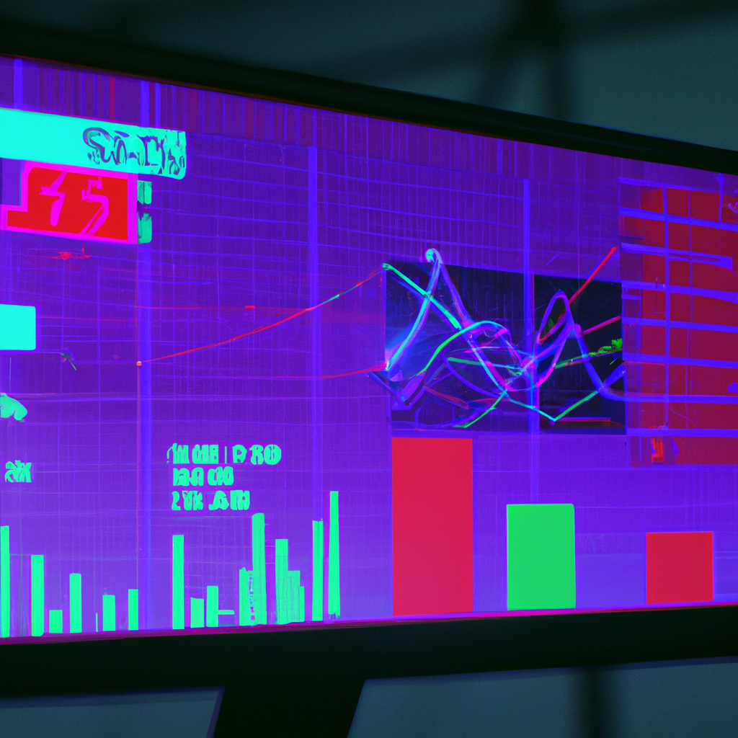
Introduction
Our main aim is to create a prediction model which can predict the growth rate of a youtuber based on various attributes such as Duration of video, likes of videos ,comments ,views, total subscribers.
The outcome of this problem is to explore various youtube optimization techniques including video quality, relevance, consistency,watch time and many more.

Slide 3

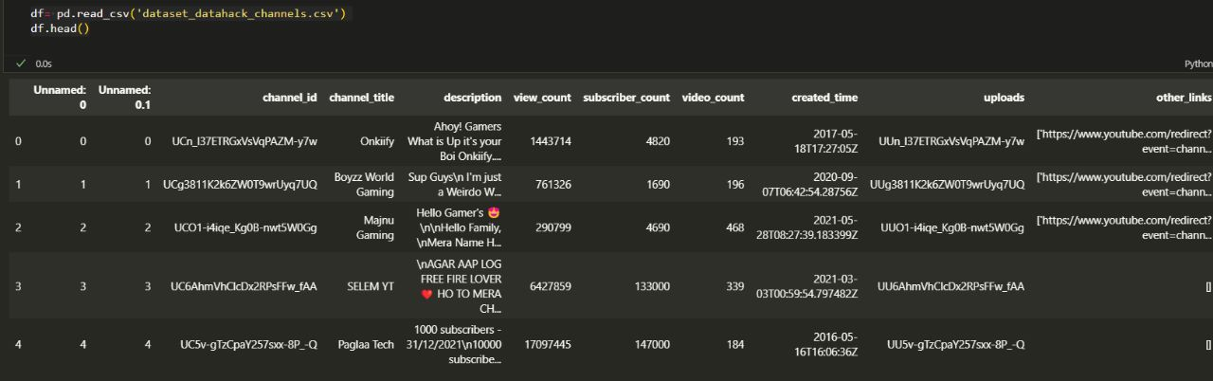
Different Analysis Sets
Channel Data Analysis
It consists of various data attributes considering channel_id a primary key along with common attribute of channel_title in both the datasets
Video Data Analysis
It consists of data attributes like video_id, likes, views,comments,etc and a common attribute of channel_title .

Slide 4

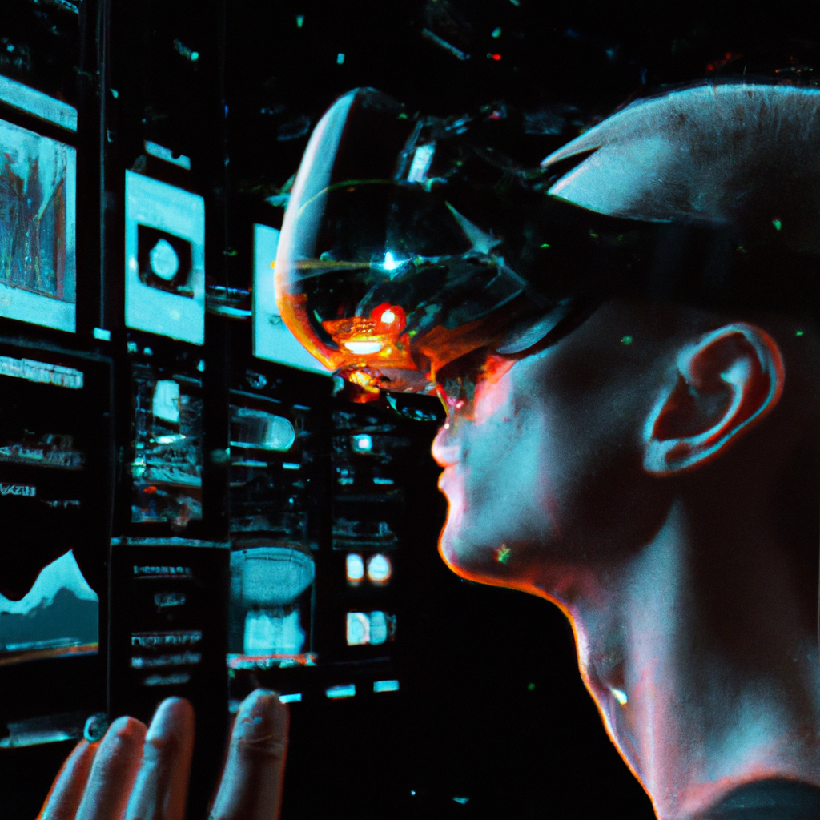
Benefits of AI/ML For Analysis
AI/ML-based data analysis provides numerous benefits to content creators and marketers. One of the significant advantages is that it allows them to gain insights into their audience's behavior and preferences. By analyzing user engagement, watch time, and other metrics, they can identify patterns and trends that can inform their content strategy.
Another benefit of AI/ML YouTube data analysis is that it enables content creators to optimize their videos for maximum engagement. By analyzing the performance of their videos, they can identify what works and what doesn't, and make changes accordingly. This can lead to increased views, likes, and shares, which can ultimately translate into higher revenue.

Slide 5
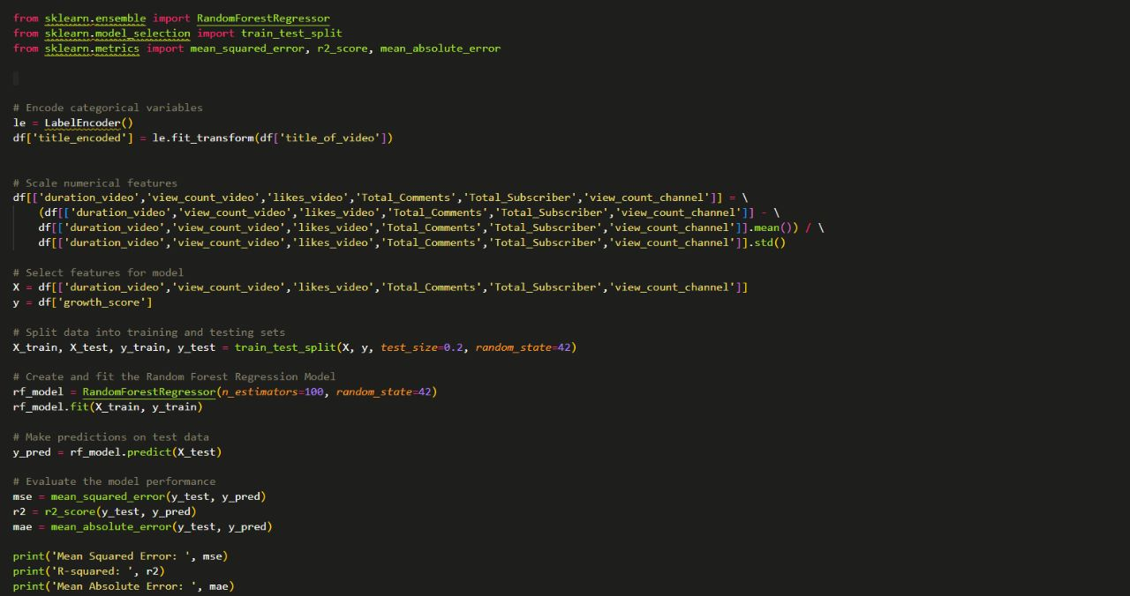
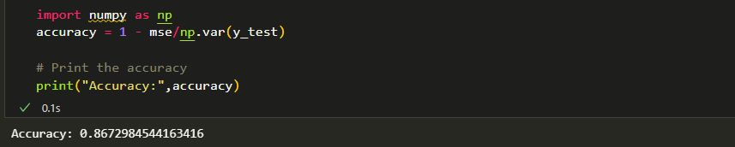
Model Development

Slide 6
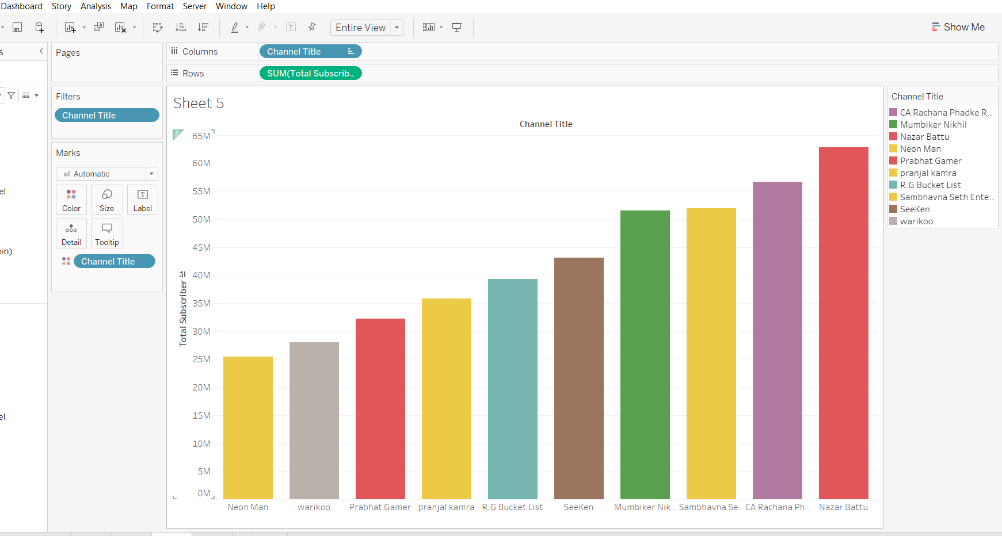
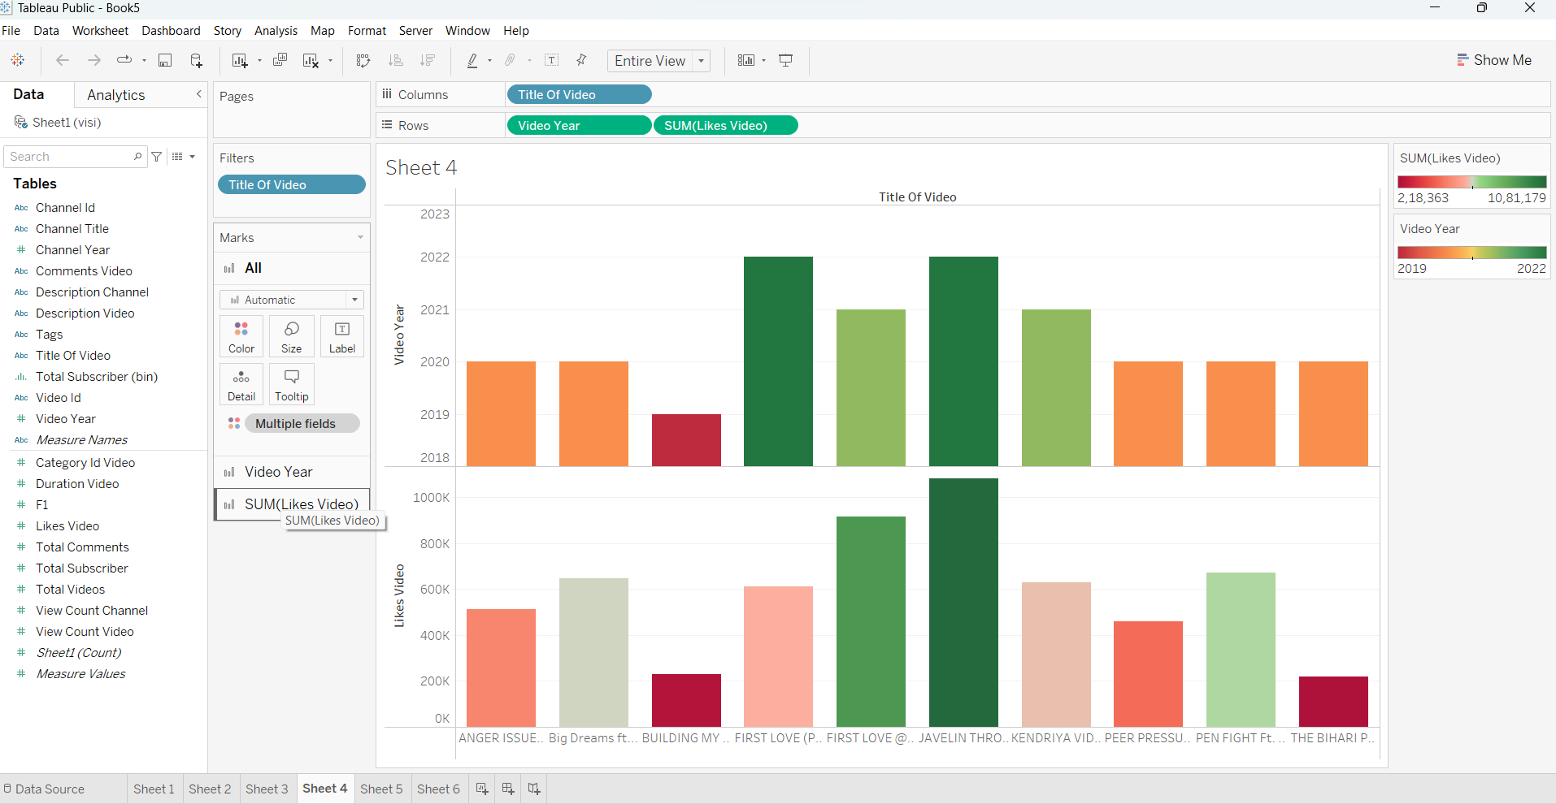
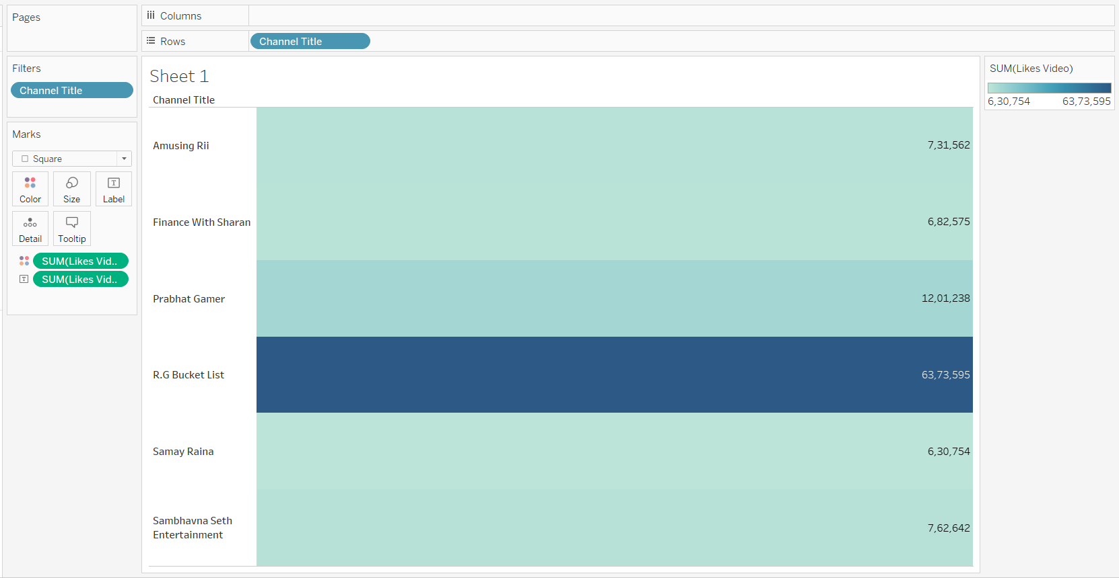
Visualizations

Slide 7

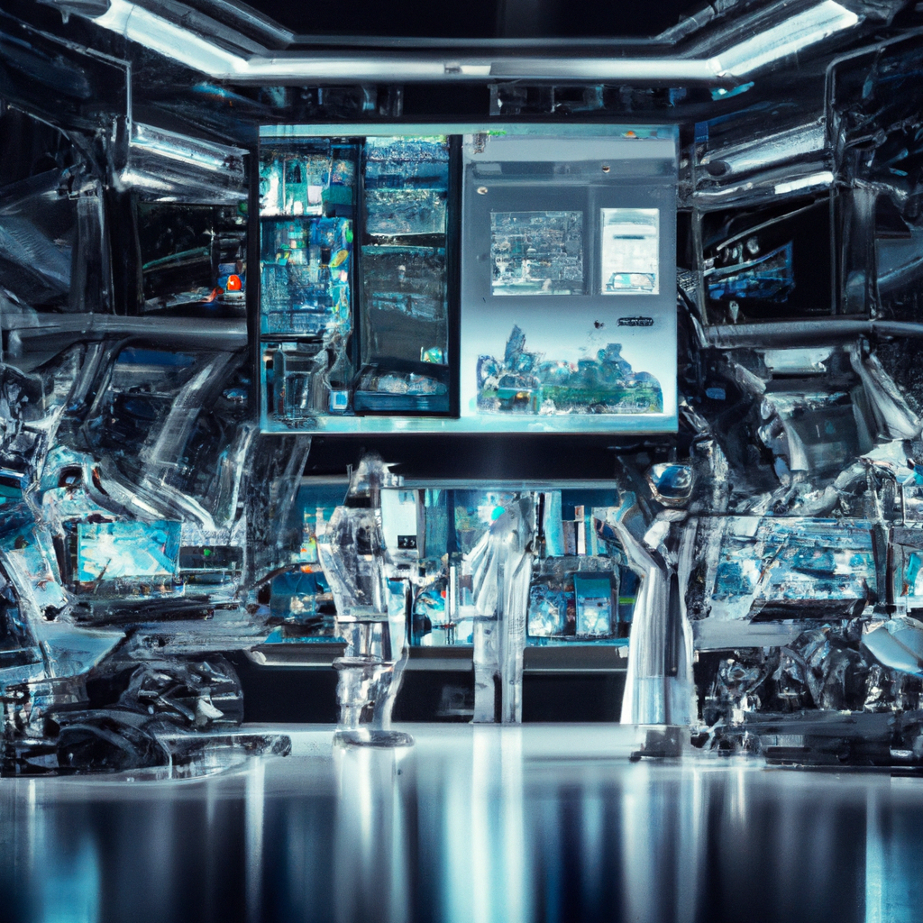
Challenges of AI/ML YouTube Data Analysis
While AI/ML-based data analysis offers significant benefits, it also poses some challenges. One of the main challenges is the accuracy of the data. YouTube's algorithms are complex, and there are many factors that can influence a video's performance. As a result, data analysis must be done carefully to ensure that the insights gained are accurate and reliable.
Another challenge of AI/ML YouTube data analysis is the need for specialized skills and expertise. Analyzing large data sets requires knowledge of programming languages such as Python and R, as well as statistical modeling and machine learning techniques. Without these skills, it can be challenging to extract meaningful insights from the data.

Slide 8

Applications of AI/ML YouTube Data Analysis
AI/ML-based data analysis has numerous applications in the world of YouTube content creation and marketing. One of the most significant applications is in content optimization. By analyzing user behavior and preferences, content creators can tailor their videos to meet their audience's needs and interests. This can lead to increased engagement and higher revenue.
Another application of AI/ML YouTube data analysis is in influencer marketing. By analyzing user engagement and other metrics, marketers can identify influencers who are likely to resonate with their target audience. This can lead to more effective influencer campaigns and higher ROI.

Slide 9


Future of AI/ML YouTube Data Analysis
As technology continues to evolve, the future of AI/ML YouTube data analysis looks bright. Advancements in machine learning and natural language processing are making it easier to extract insights from large data sets, while improvements in data visualization are making it easier to communicate those insights effectively.
One potential area of growth for AI/ML YouTube data analysis is in personalized content recommendations. By analyzing user behavior and preferences, AI algorithms can recommend videos that are tailored to each user's unique interests. This can lead to increased engagement and higher retention rates.

Slide 10

Conclusion
AI/ML-based data analysis is transforming the world of YouTube content creation and marketing. By providing insights into user behavior and preferences, it is helping content creators and marketers optimize their content and reach their target audience more effectively. While there are challenges to overcome, the future of AI/ML YouTube data analysis looks promising.

Slide 11
THANK YOU

